Slide 1
May 26 - June 1
Main focus:
For linguistics features, we break down into each course and each srt file to spot outliers and do data visualization exploration
See if there’s a correlation between readability index and the difficulty of the course (the level)
Text coherence, course level & chapter level
Tree based models

Slide 2
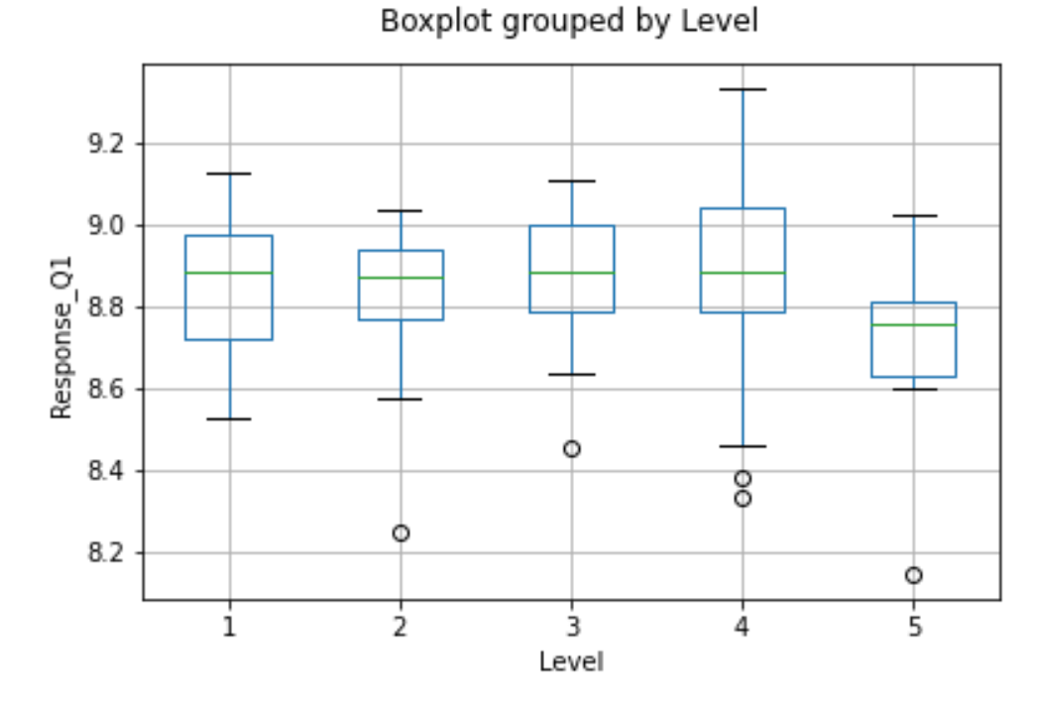
Score VS. Level

Slide 3
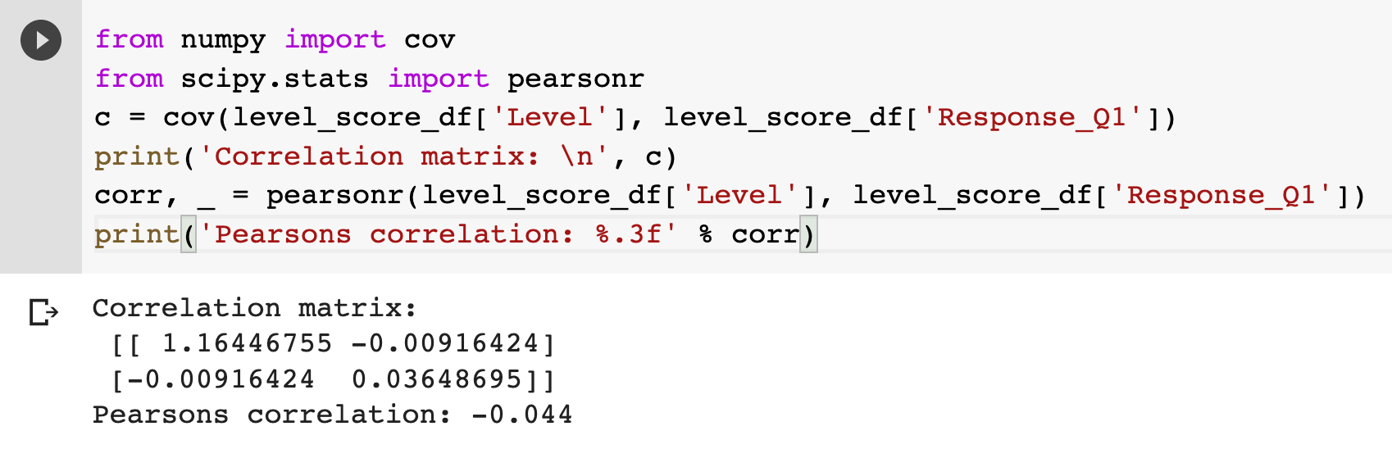
Score VS. Level

Slide 4
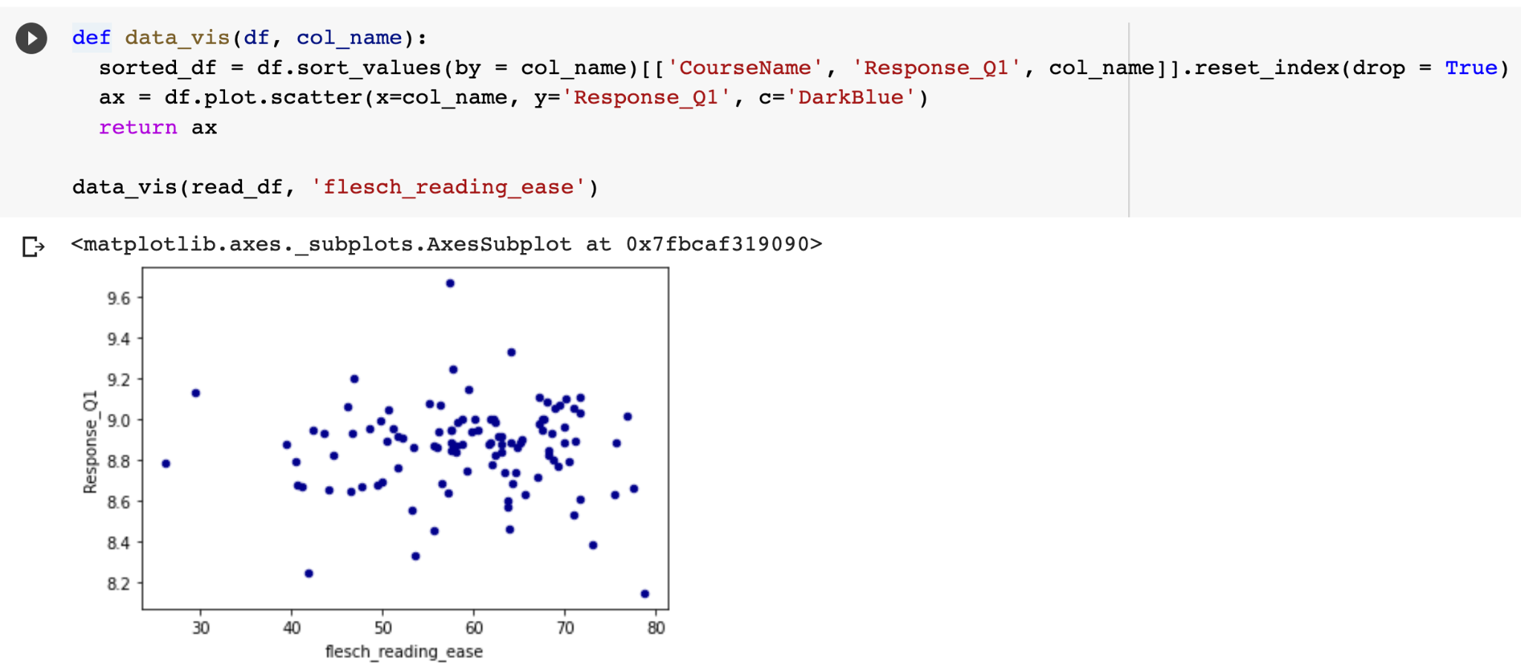
Data visualization of a particular linguistics feature

Slide 5
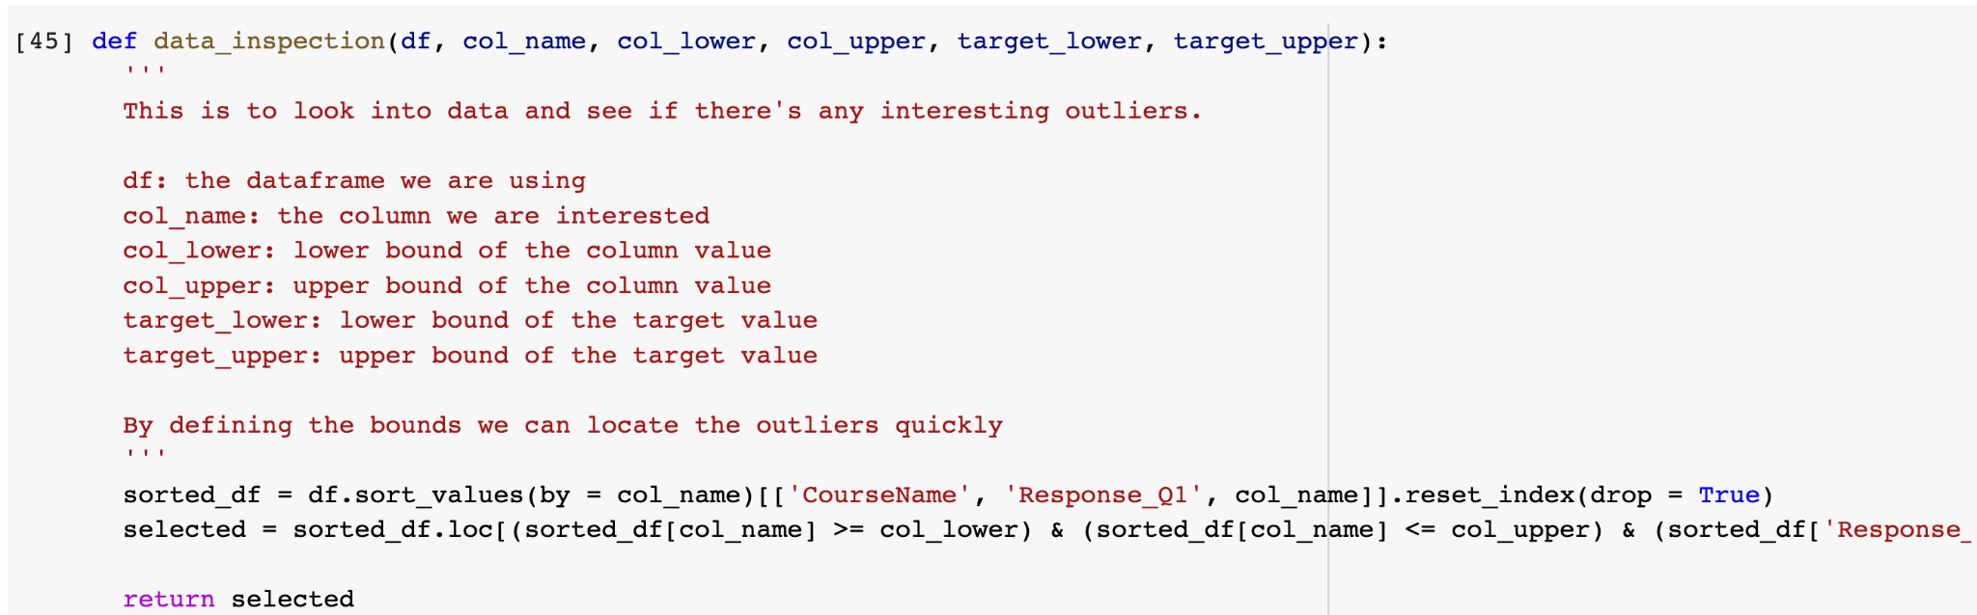
Data inspection to spot those outliers

Slide 6
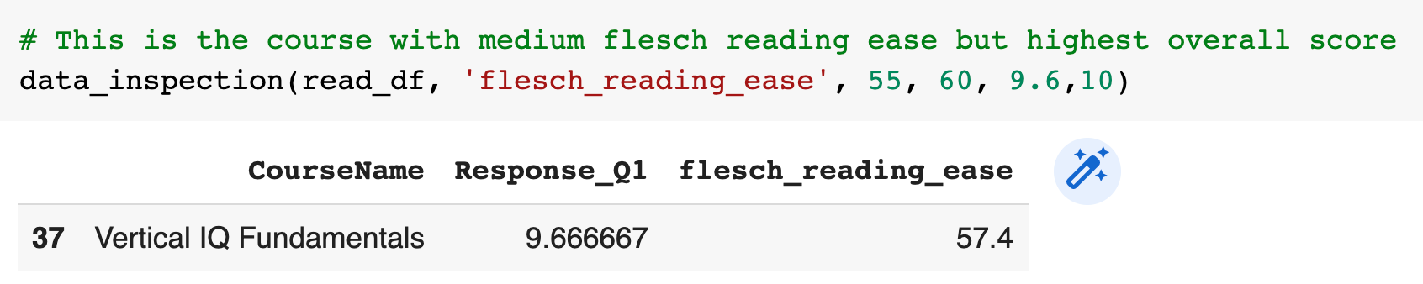
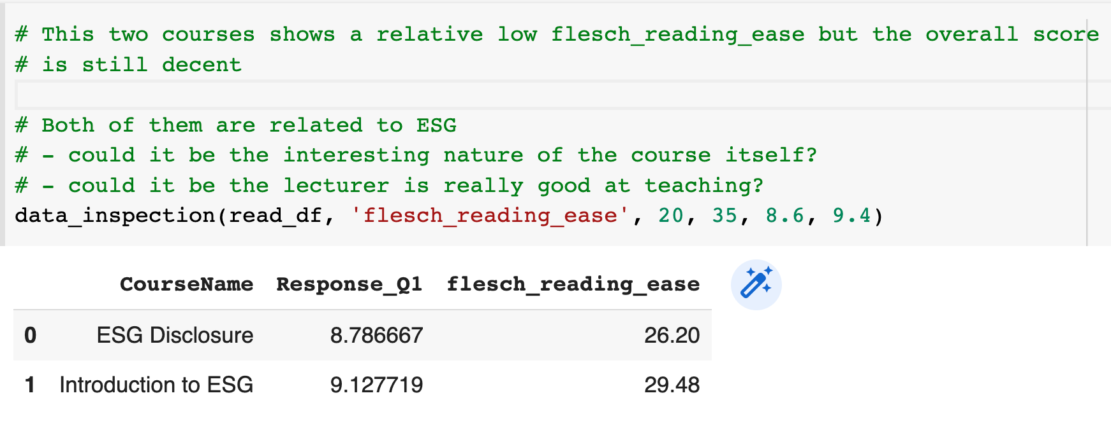
Data inspection for
Flesch reading ease

Slide 7
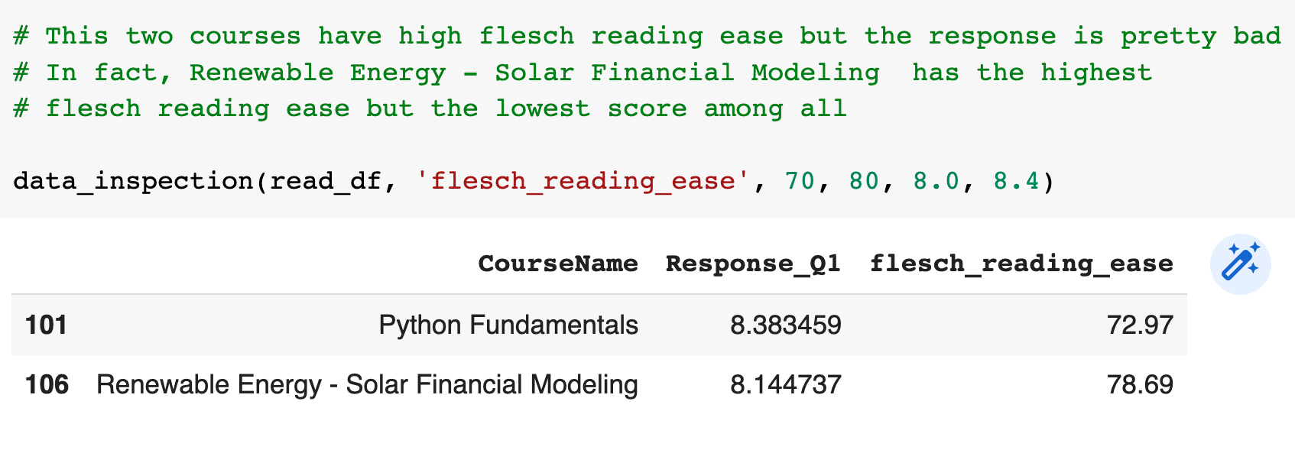
Data inspection for
Flesch reading ease

Slide 8
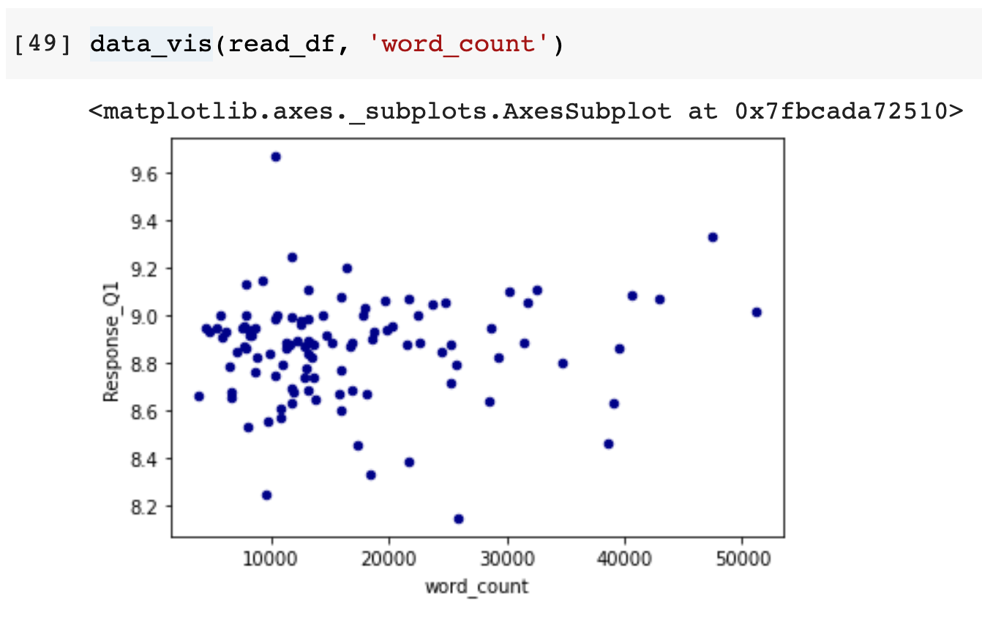
Data inspection for
Word count

Slide 9
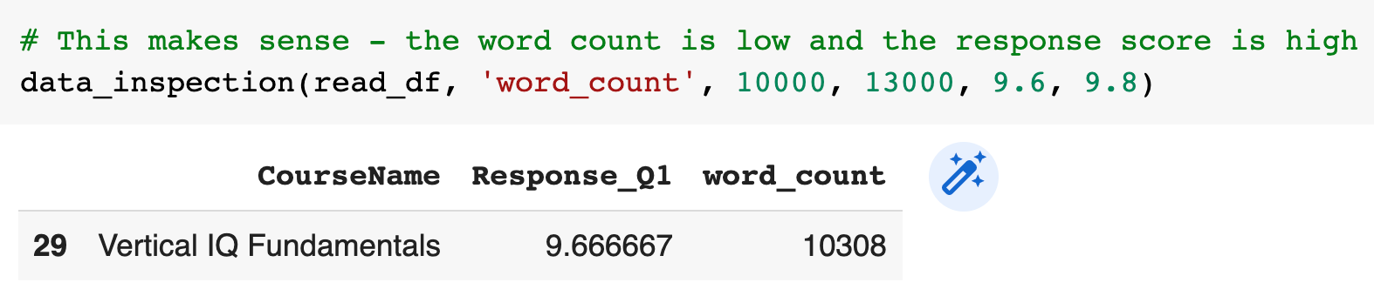
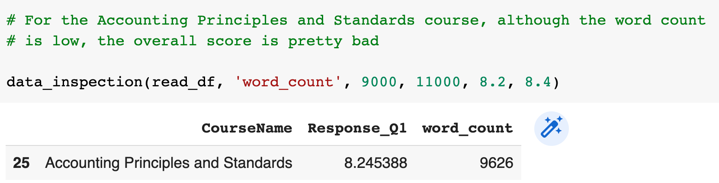
Data inspection for
Word count

Slide 10
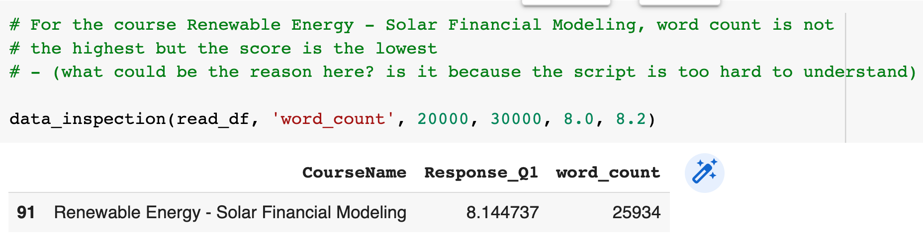
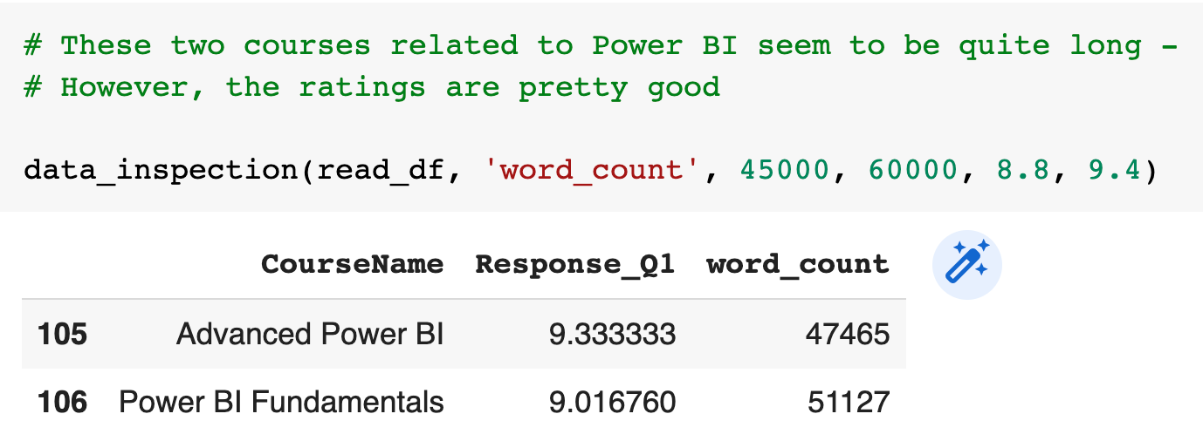
Data inspection for
Word count

Slide 11
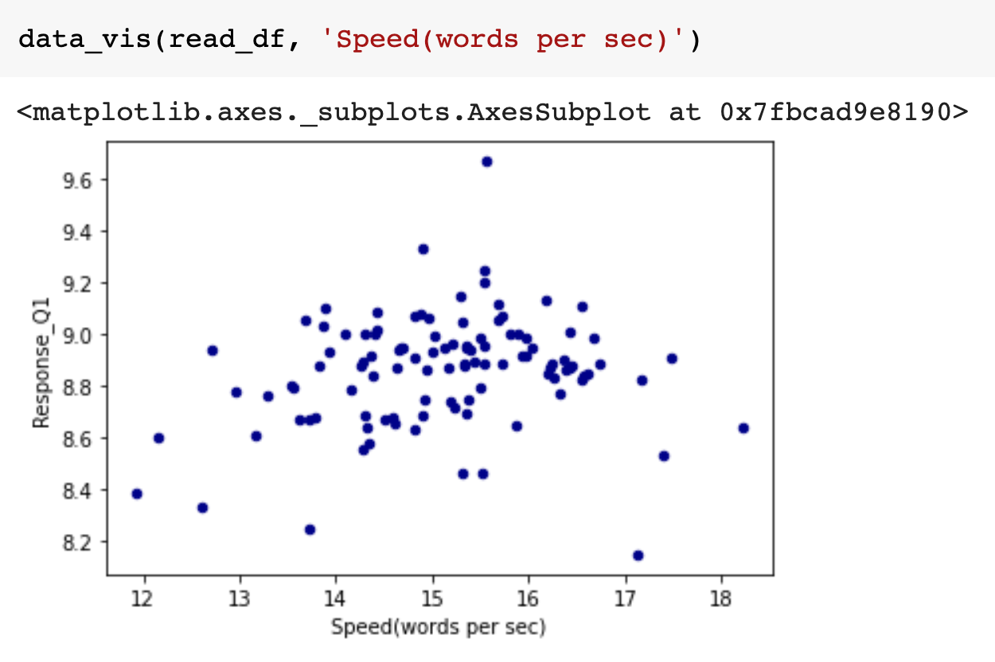
Data inspection for
Speed

Slide 12
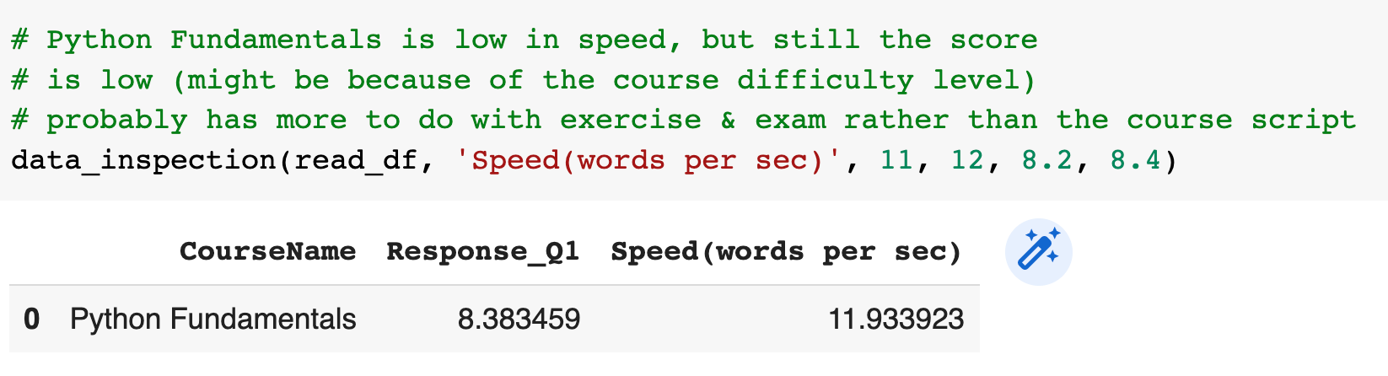
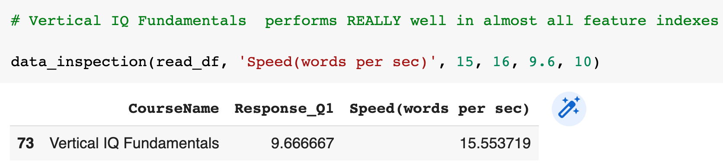
Data inspection for
Speed

Slide 13
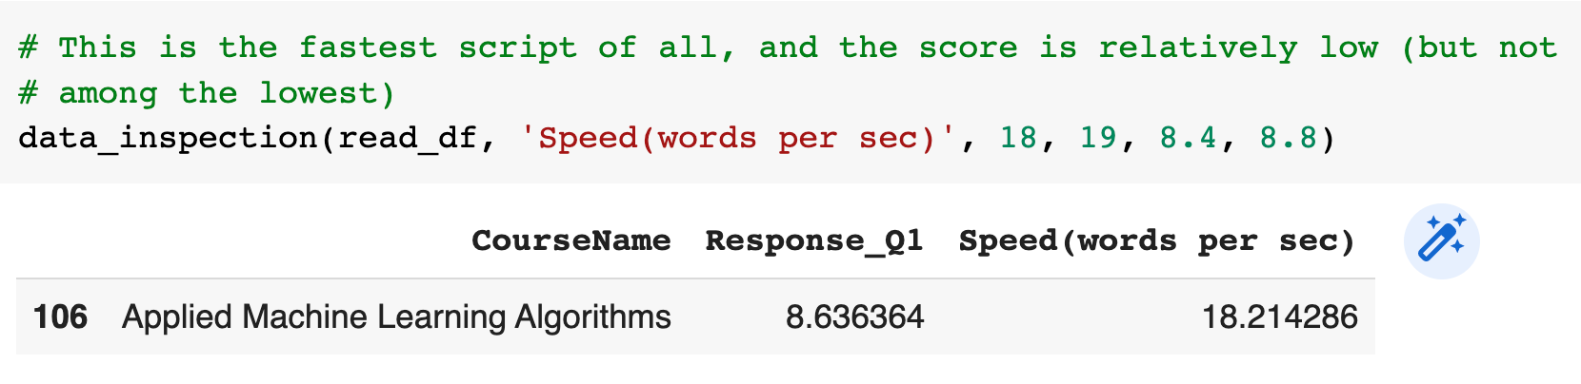
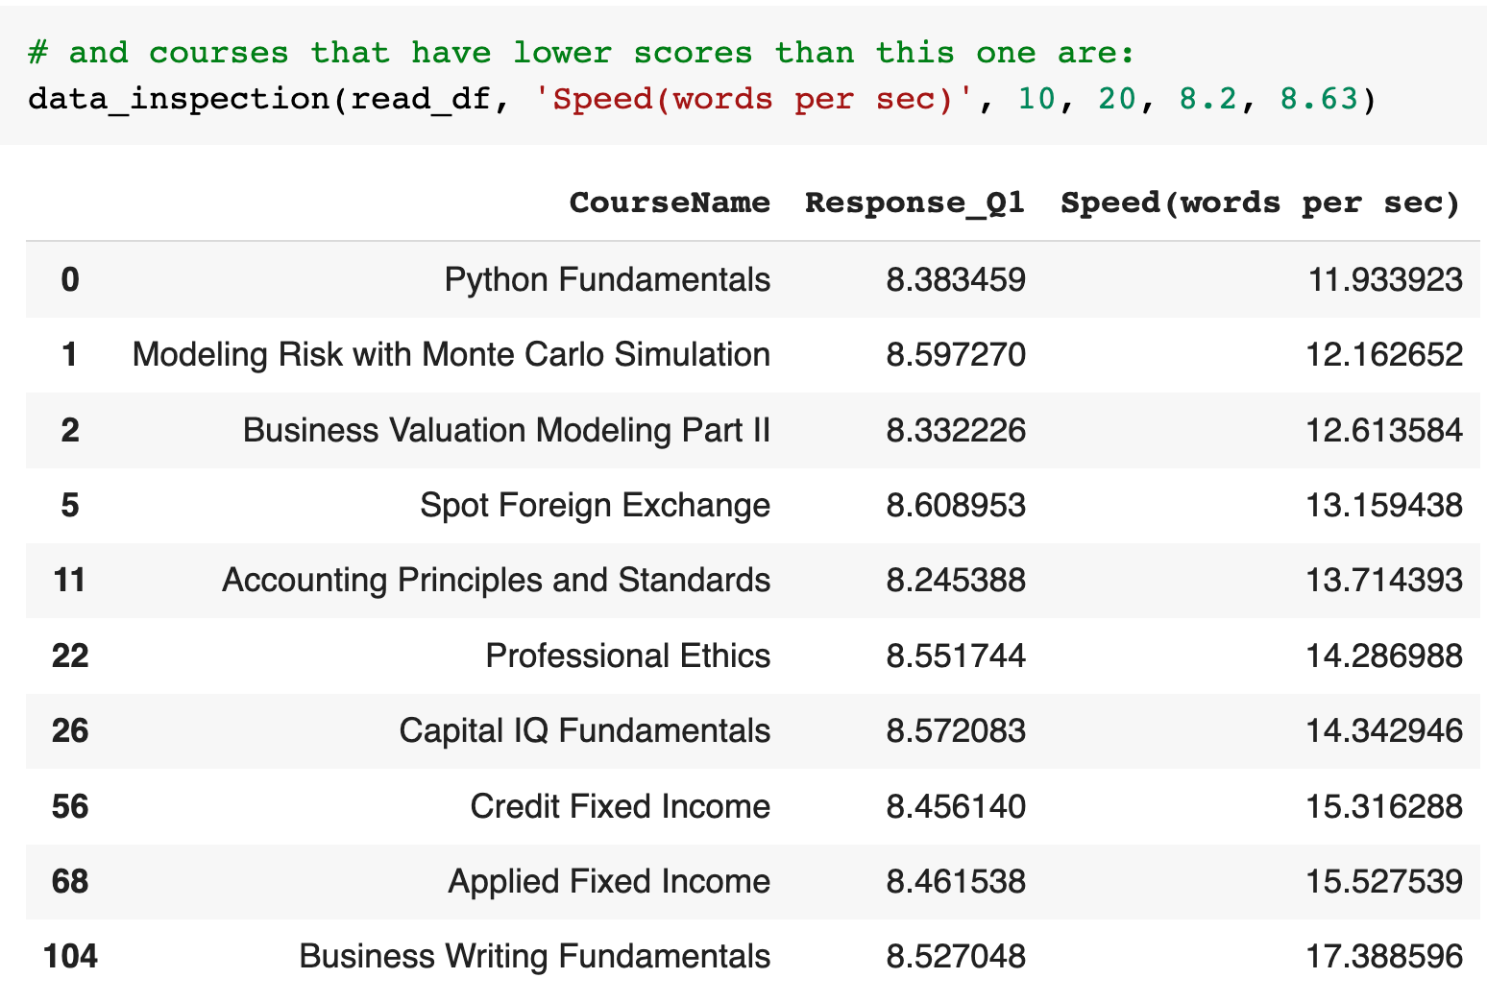
Data inspection for
Speed

Slide 14
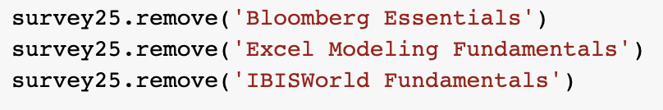
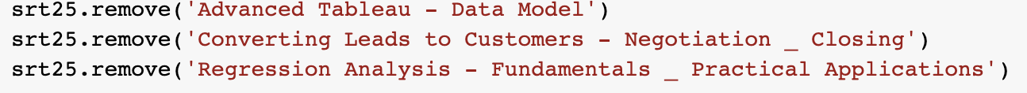
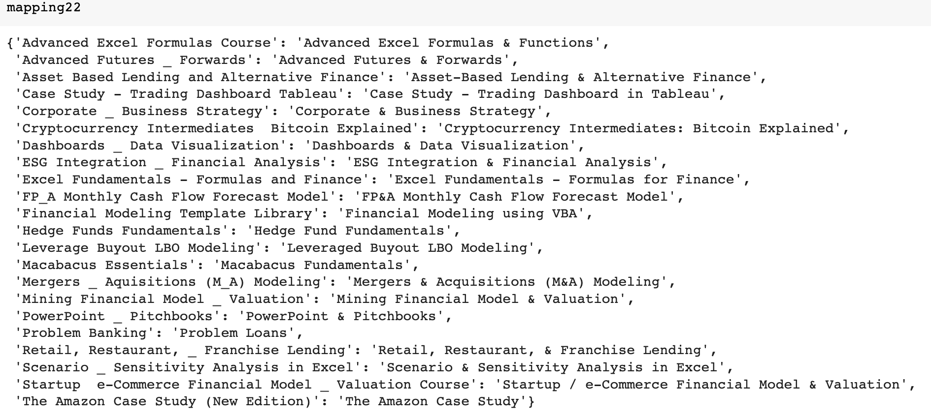
Combined the datasets by removing three exclusive courses in each file.
(129 courses left)
Mapped 22 CourseNames from the Transcript file to Survey file

Slide 15
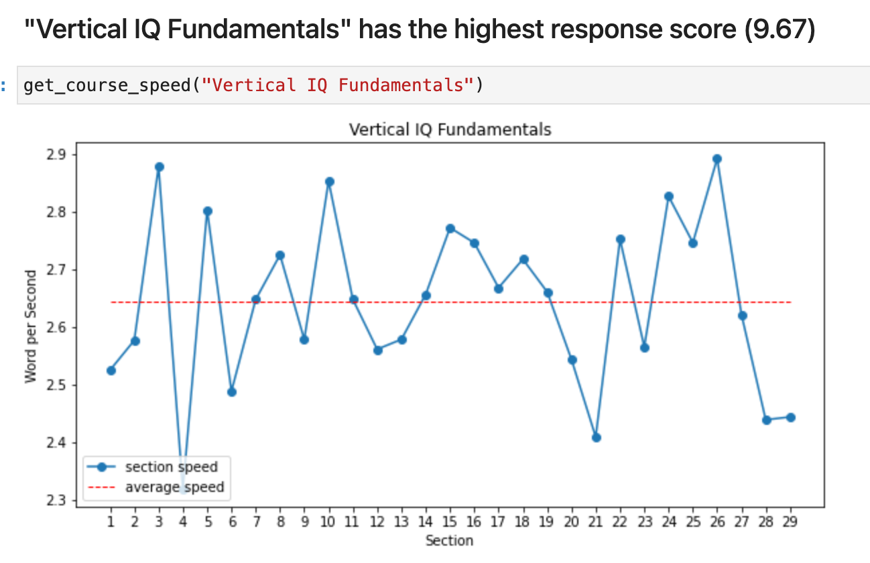
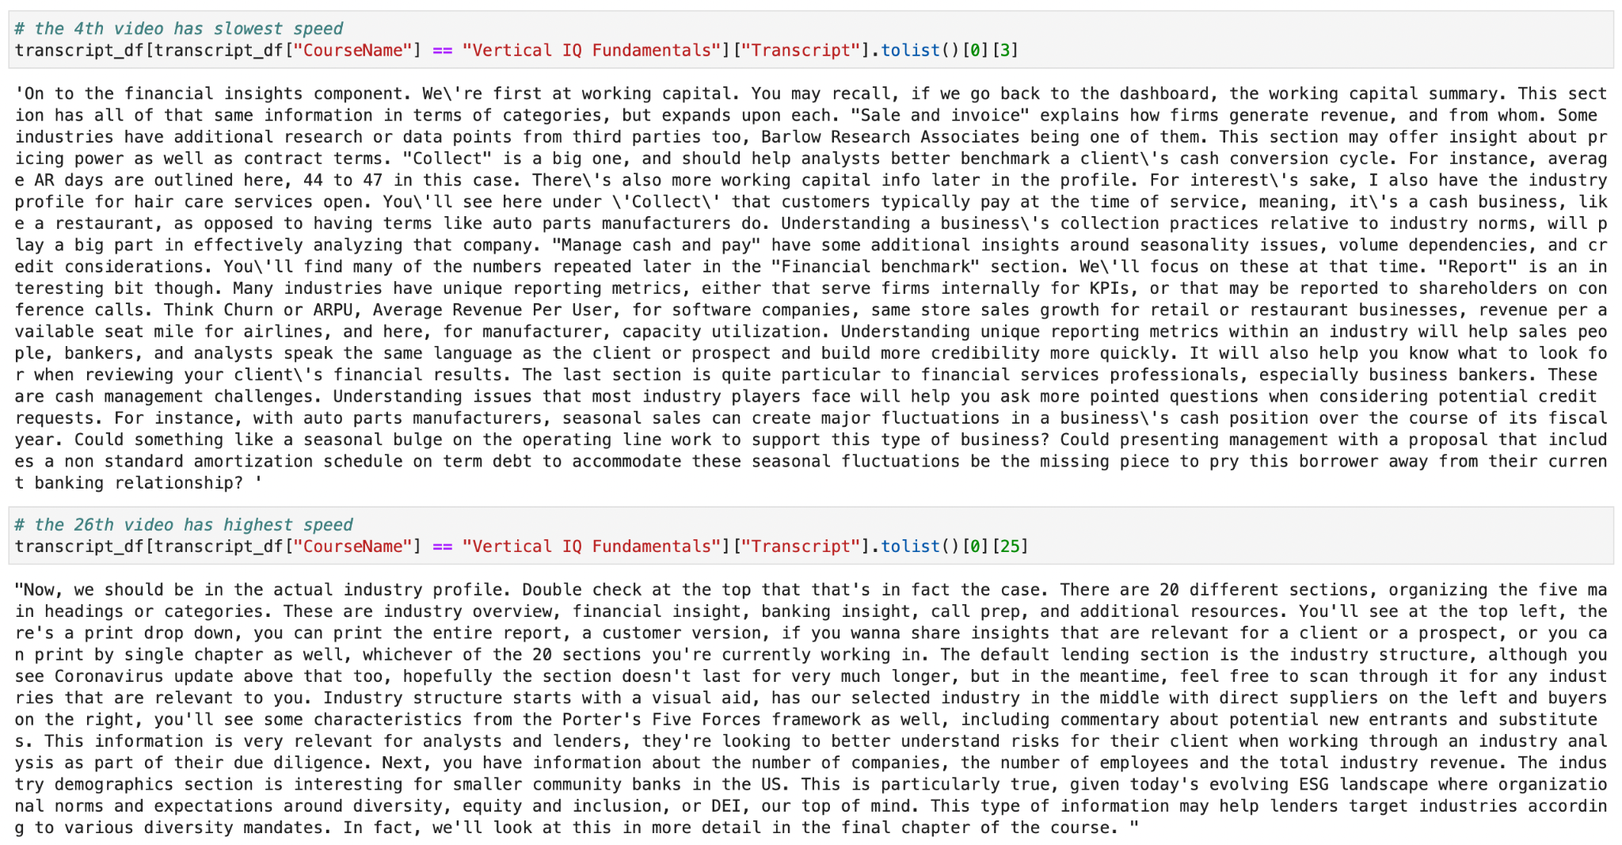
Visualize the course speed

Slide 16
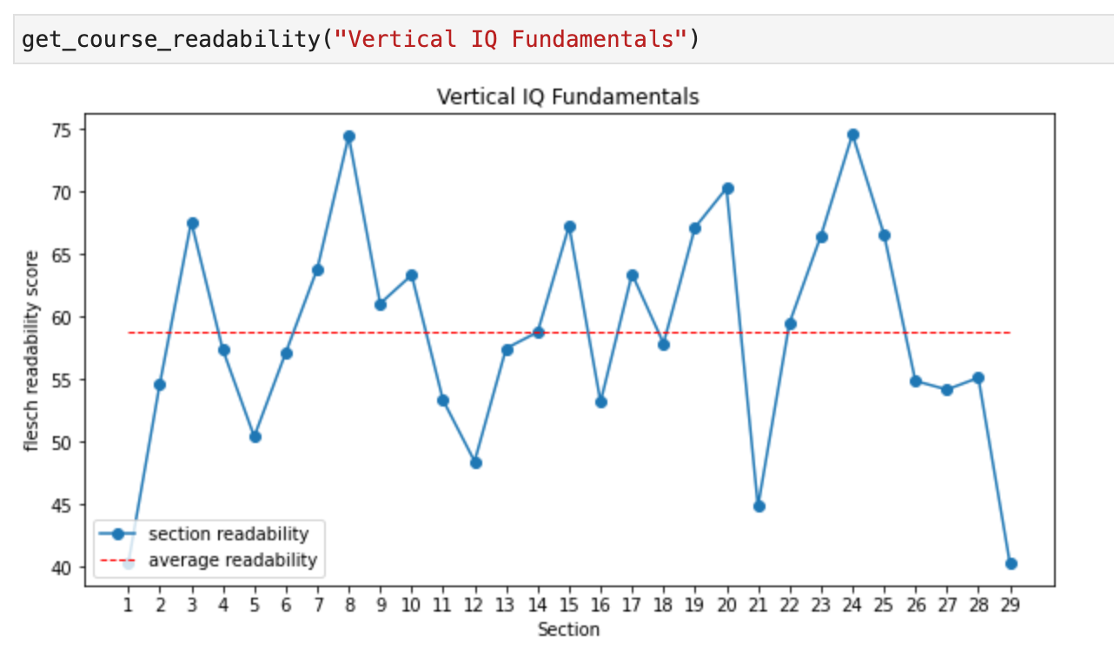

Visualize the readability score

Slide 17
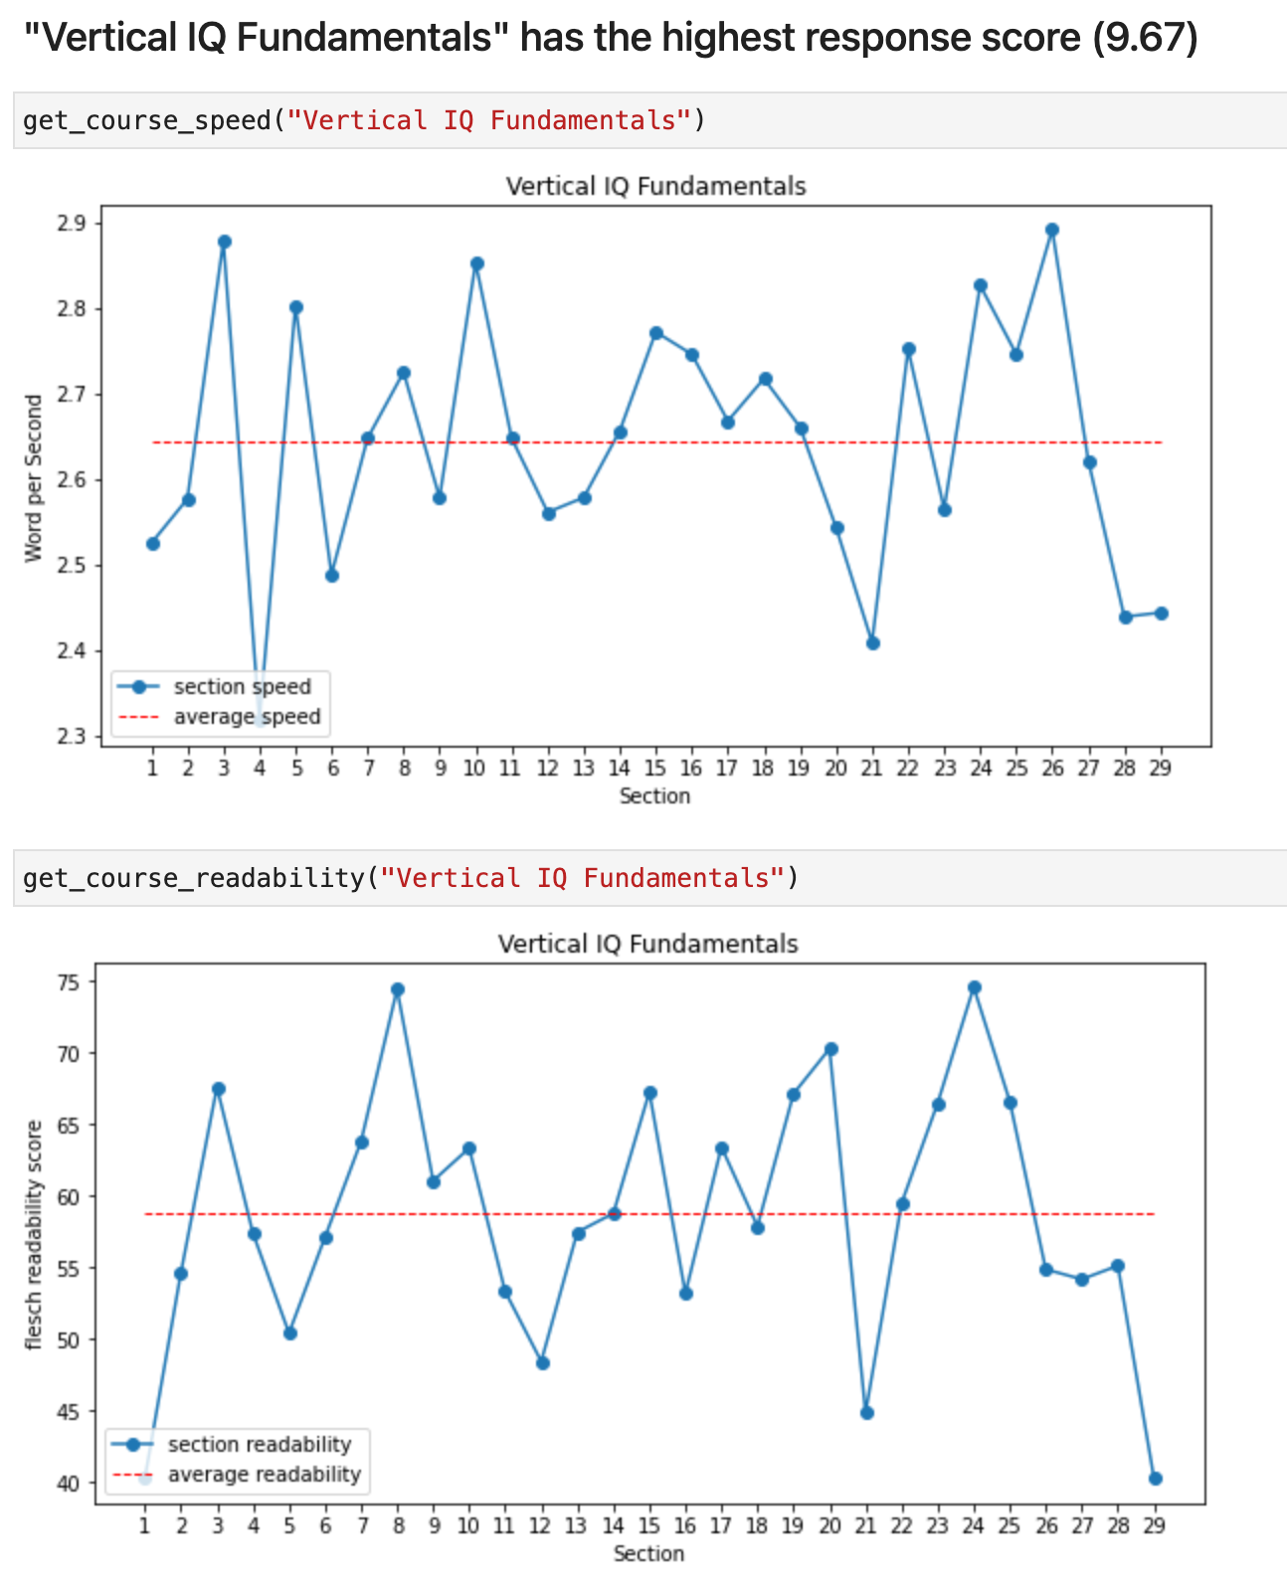
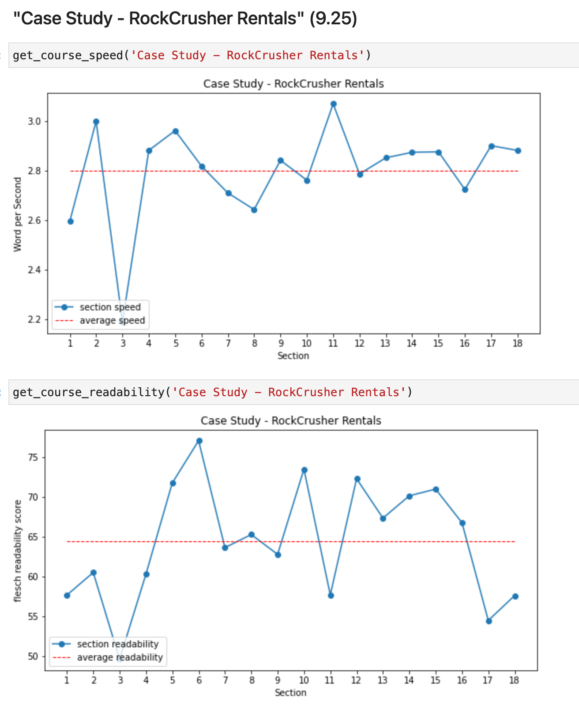

Slide 18
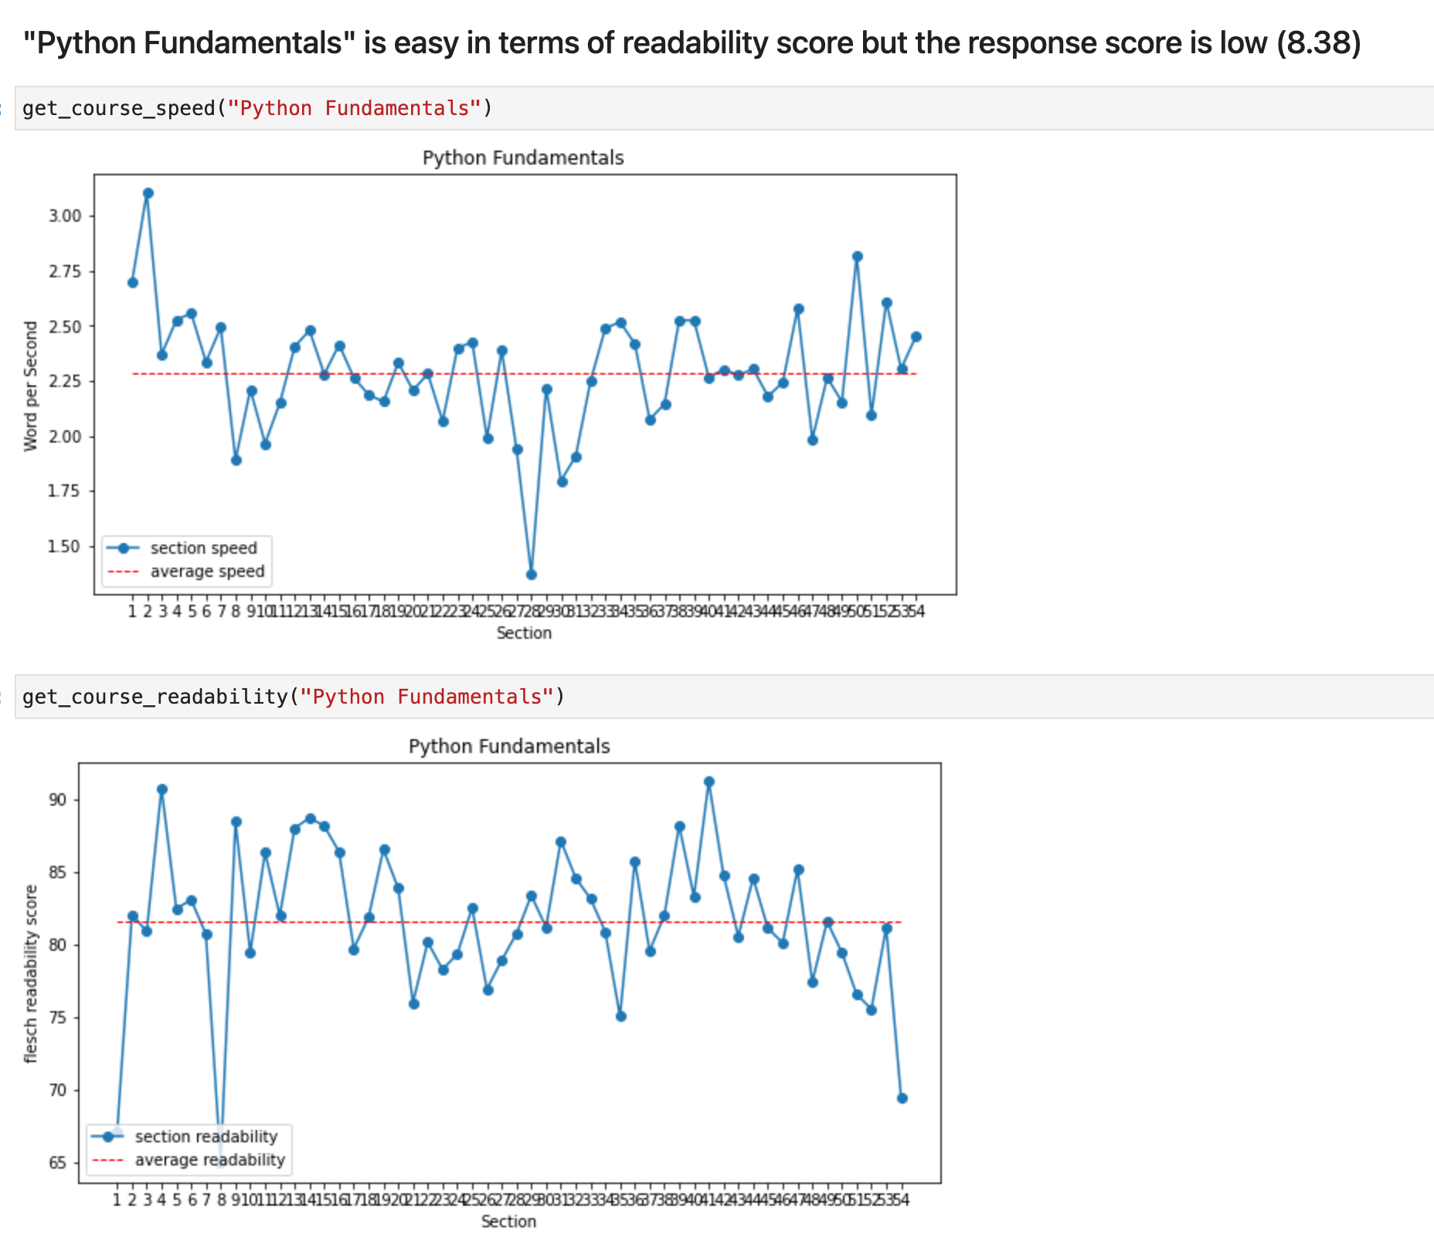

Slide 19
Text coherence using cosine similarity
Convert sentences to embeddings using Sentence Transformer from Huggingface
Compute cosine similarity between sentence vectors.
Calculate the average from both forward and backward
Starting index at i = 1, end index at i= # of sentences - 1
Output: An average score of an input text piece(an srt file transcript)
Example:
'Tom loves reading books.',
'He prefers reading books at library.' 0.6027637124061584
'Tom loves reading books.',
'He missed his lunch today.' 0.15047845244407654
Notes:
Our model is intented to be used as a sentence and short paragraph encoder. Given an input text, it ouptuts a vector which captures the semantic information. The sentence vector may be used for information retrieval, clustering or sentence similarity tasks.
Cosine similarity then gives a useful measure of how similar two documents are likely to be, in terms of their subject matter, and indepently of the length of the documents.

Slide 20
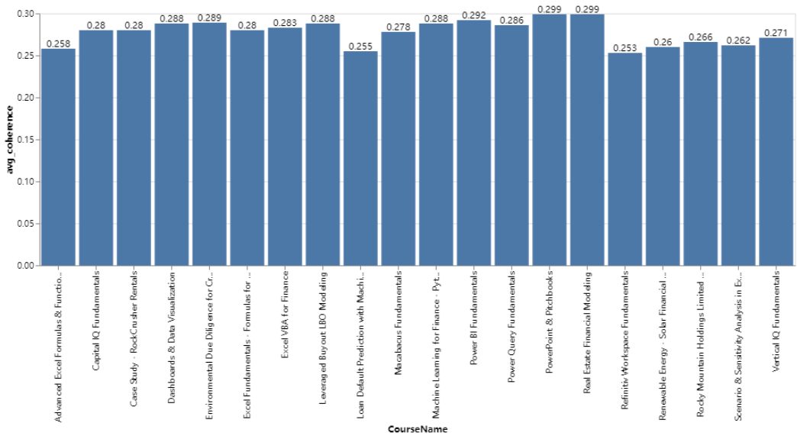
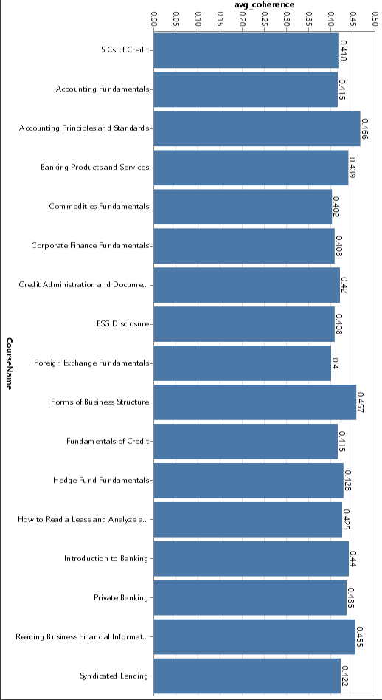
Visualization of average coherence distribution
All courses with >0.4 coherence All courses with <0.3 coherence

Slide 21
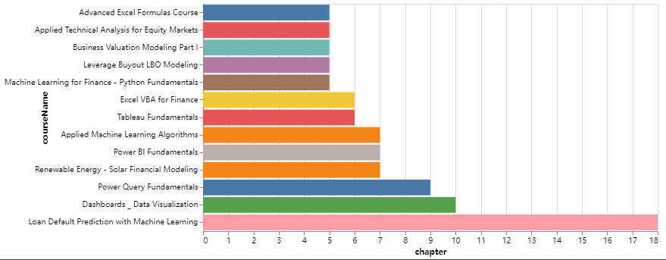
Visualization of average coherence distribution
Lowest 200 chapters - course distribution

Slide 22
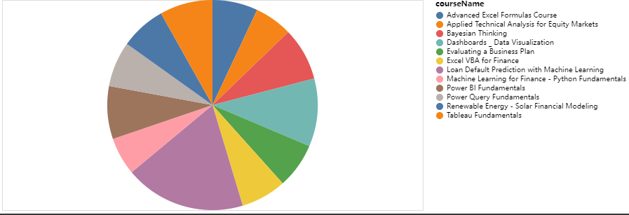
Visualization of average coherence distribution

Slide 23
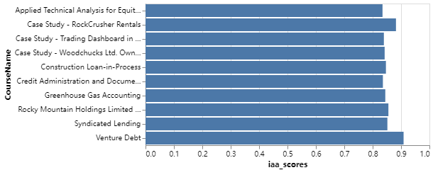
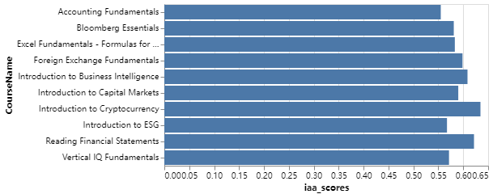
Inter-Annotator Agreement (Q2 & Q3)
—-Pair-wise Cohen kappa
Cohen’s 𝜅: two annotators annotating each instance with a category
Top 10 (excluding 1.0 or NaN)
Bottom 10

Slide 24
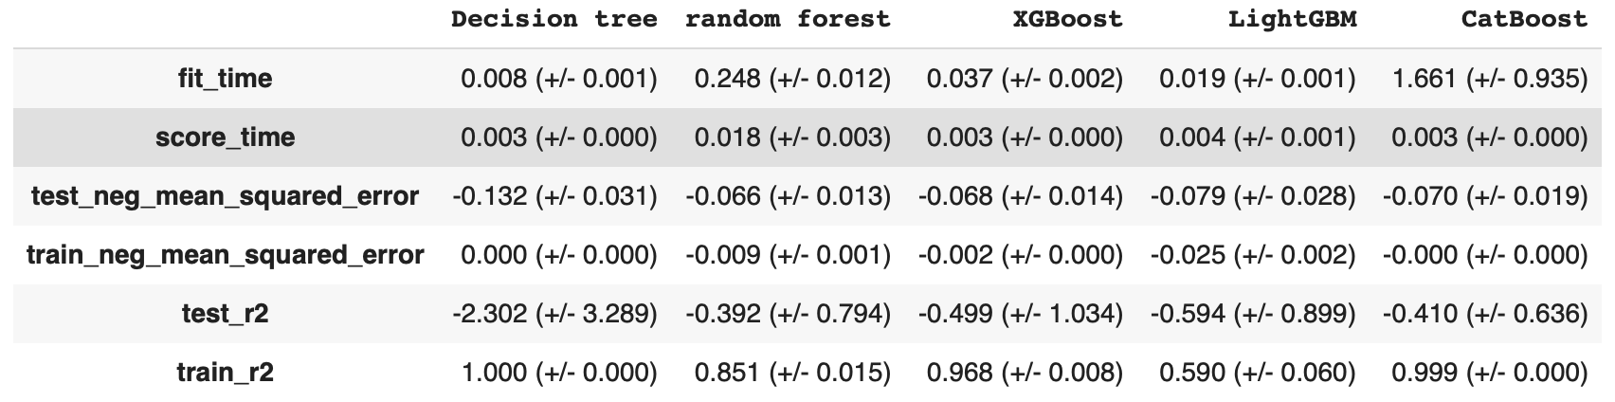
Tree based models with course level data
Model performance (with default hyperparameters)
Model overfitting due to small data size (129 data points)
Negative test r2: model fits badly

Slide 25
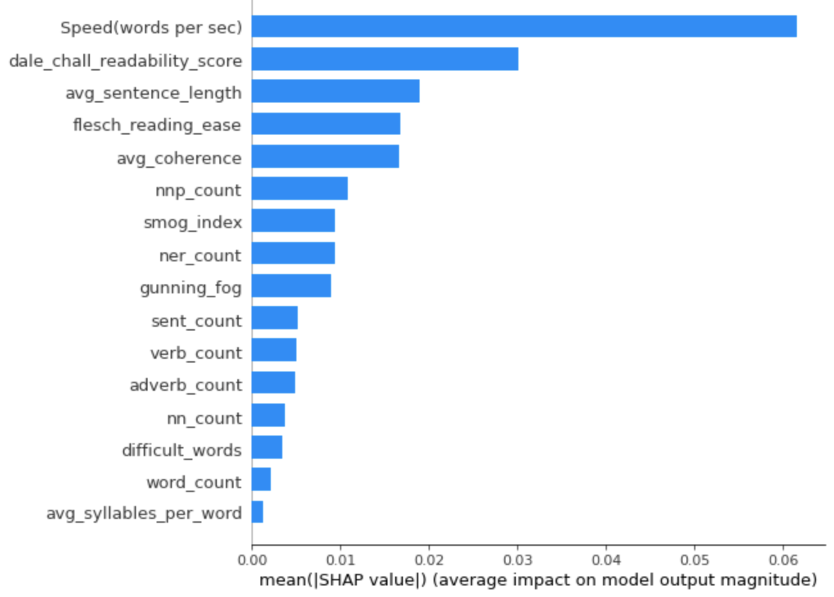
Tree based models with course level data
Feature importance

Slide 26
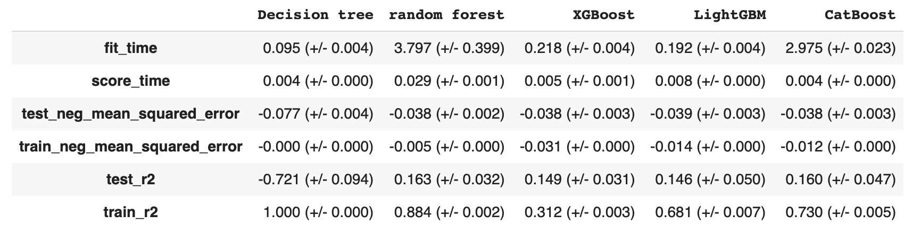
Tree based models with chapter level data
Model performance (with default hyperparameters)
Still overfitting, but at model performance is significantly improved (5041 data points)
Main tasks this week: improve model performance
Feature selection - remove redundant features
Hyperparameter tuning

Slide 27
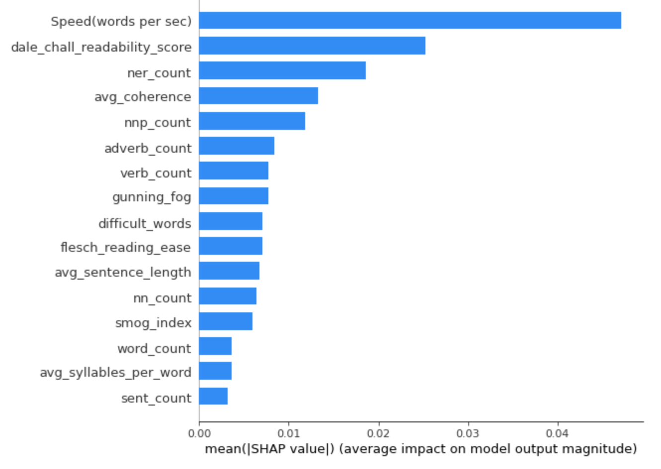
Tree based models with chapter level data
Feature importance

Slide 28

Tree based models with course level data
Shap force plot interpretation
The raw model score is higher than the base score, the predicted response_q1 score is higher than average according to the model
Some of the forces driving the prediction towards smaller value are (features in blue): Verb count
Some of the forces driving the prediction towards larger value are (features in red): speed, difficult word
(May not make much sense at the moment since model performance needs improving)

Slide 29
